Slide 1
Smart Power Grids with Toumetis
Group F – MSc Computer Science Summer Project
Supervisor: Professor Kerstin Eder
Client: Doctor Edward Roland from Toumetis
Members: Riley Lee, Oliver Lin, Jasper Li, Qi Zhao, Xihao Wang

Slide 2

Project Introduction
Company: Toumetis
Software development
Data Science team
Two main parts:
Automation of the classification process for abnormal signals
Web app

Slide 3
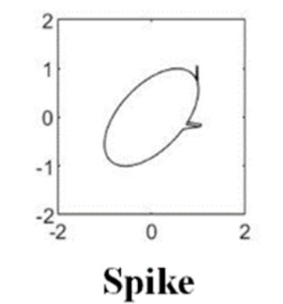
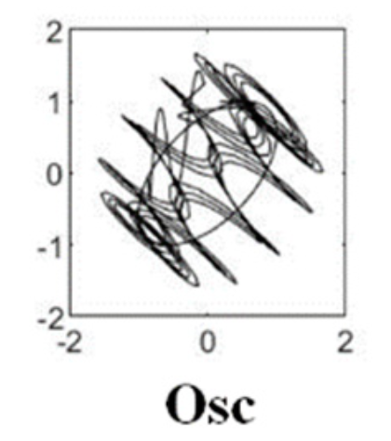
Background
Identify power quality disturbances (PQDs)
Predictive maintenance
Reduce accidents
Current workflow:
Power Events Data
Labelled & classified PQDs
Engineers
Machine Learning Model

Slide 4
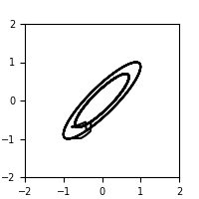
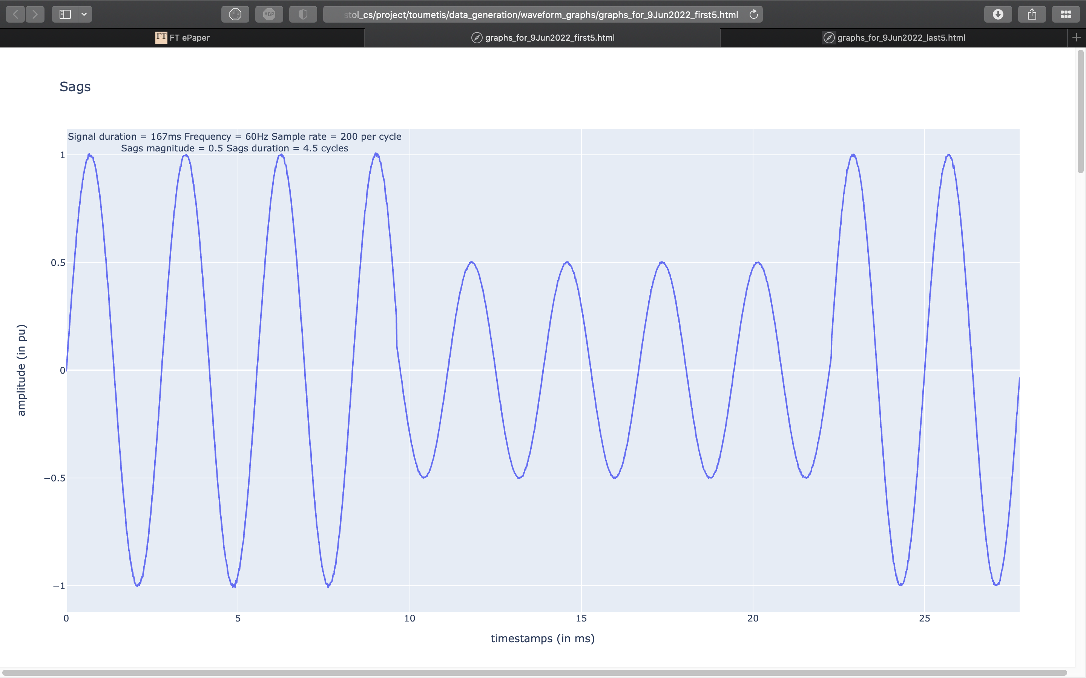
Concept
Part One: Machine Learning Model
Make use of Convolutional Neural Network (CNN)
Part Two: Data Visualization
Incorporate it to an interactive web app
Allow flexible data exploration
Dimensionality Reduction: PCA, UMAP, t-SNE
Clustering: K-Means, DBSCAN, Agglomerative Clustering

Slide 5
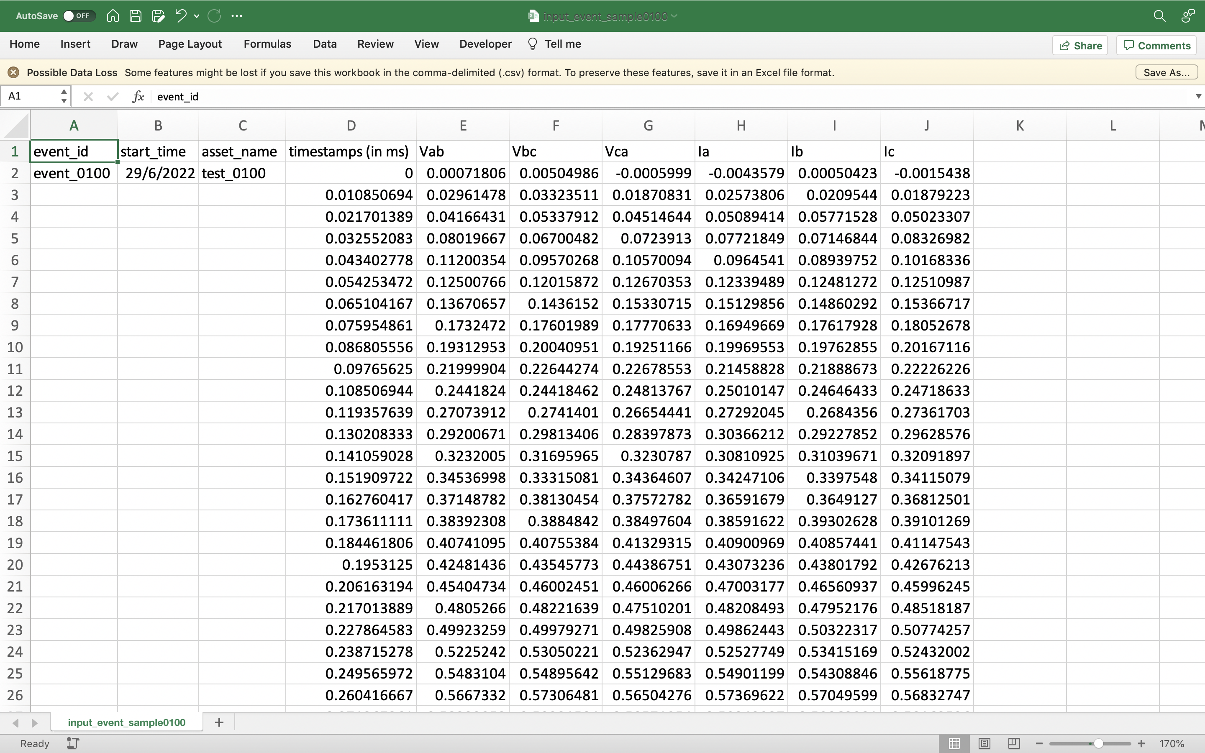
The input handling tool reads and analyzes power quality events
Power quality events in CSV file formats are the primary inputs.
1
Event metadata:
ID, time and location
2
Event’s 6 signal waveforms:
Voltages and currents

Slide 6
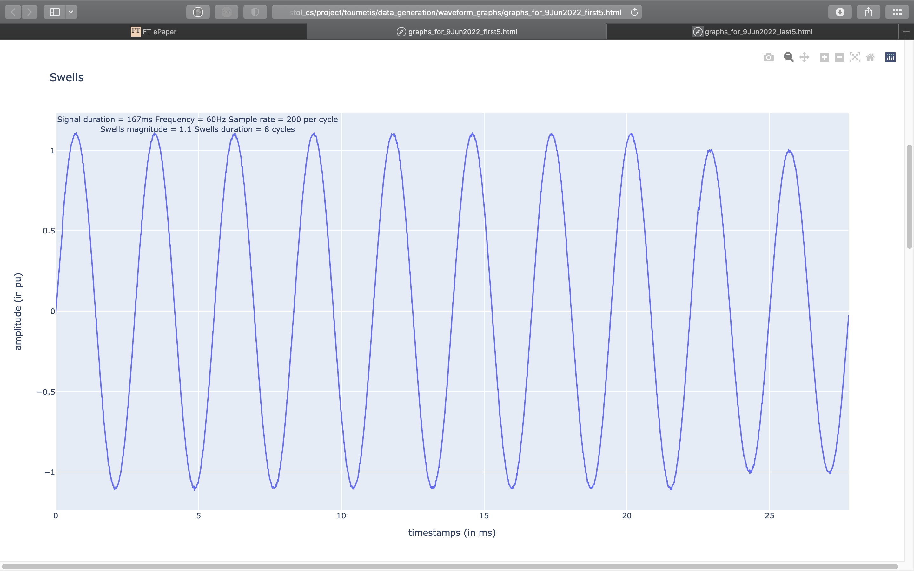
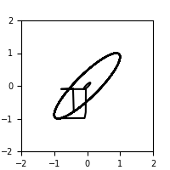
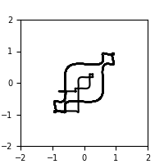
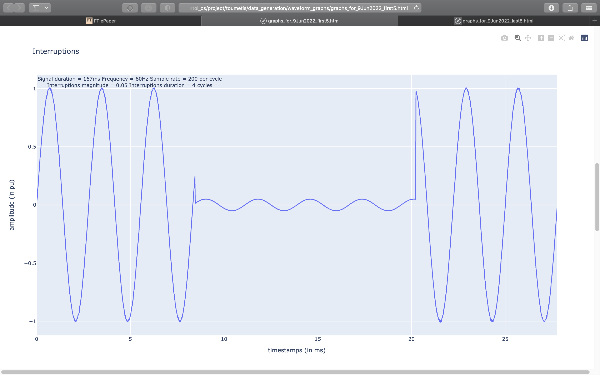
The signal waveforms of these events are transformed into 2D PSR images
1
2
Signal waveforms as
1D timeseries data
Converted into 2D Phase Space Reconstruction (PSR) images

Slide 7
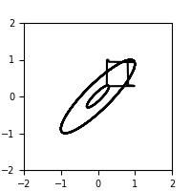
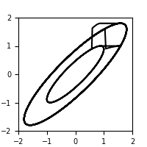
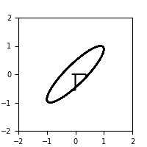
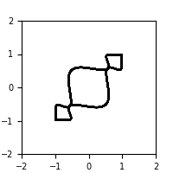
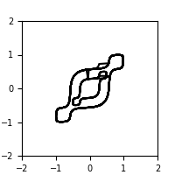
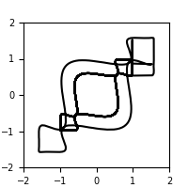

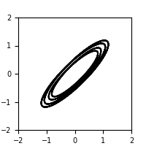
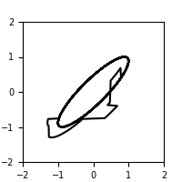
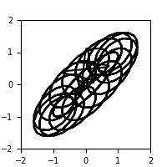
The trained CNN model performs a multi-class categorization…
1
2
CNN performs a multi-class categorization
There are 10 power quality disturbance (PQD) types
Sags | Swells | Interruptions | Harmonics | Sags w/ harmonics
Swells w/ harmonics | Interruptions w/ harmonics | Flickers | Spikes | Oscillatory Transients

Slide 8
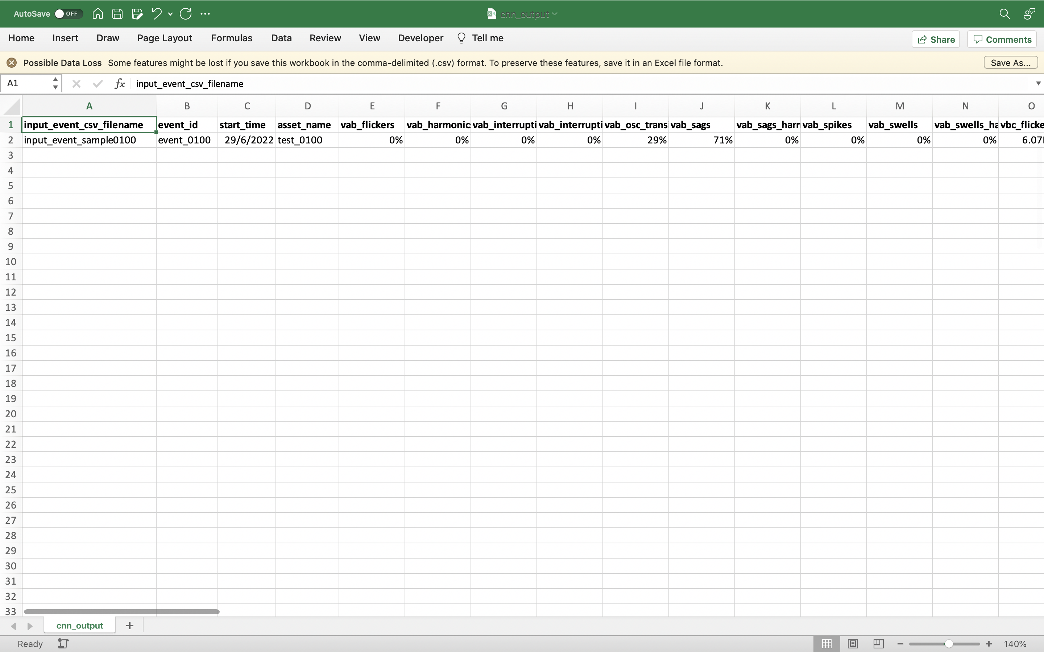
… and predicts the PQD types of the input 2D PSR images
Upon completion, the CNN model generates prediction scores for each of the image.
These scores are stored in an output CSV file.
1
Input events’ metadata
2
CNN’s prediction scores
for the PQD categories of the input 2D PSR images

Slide 9
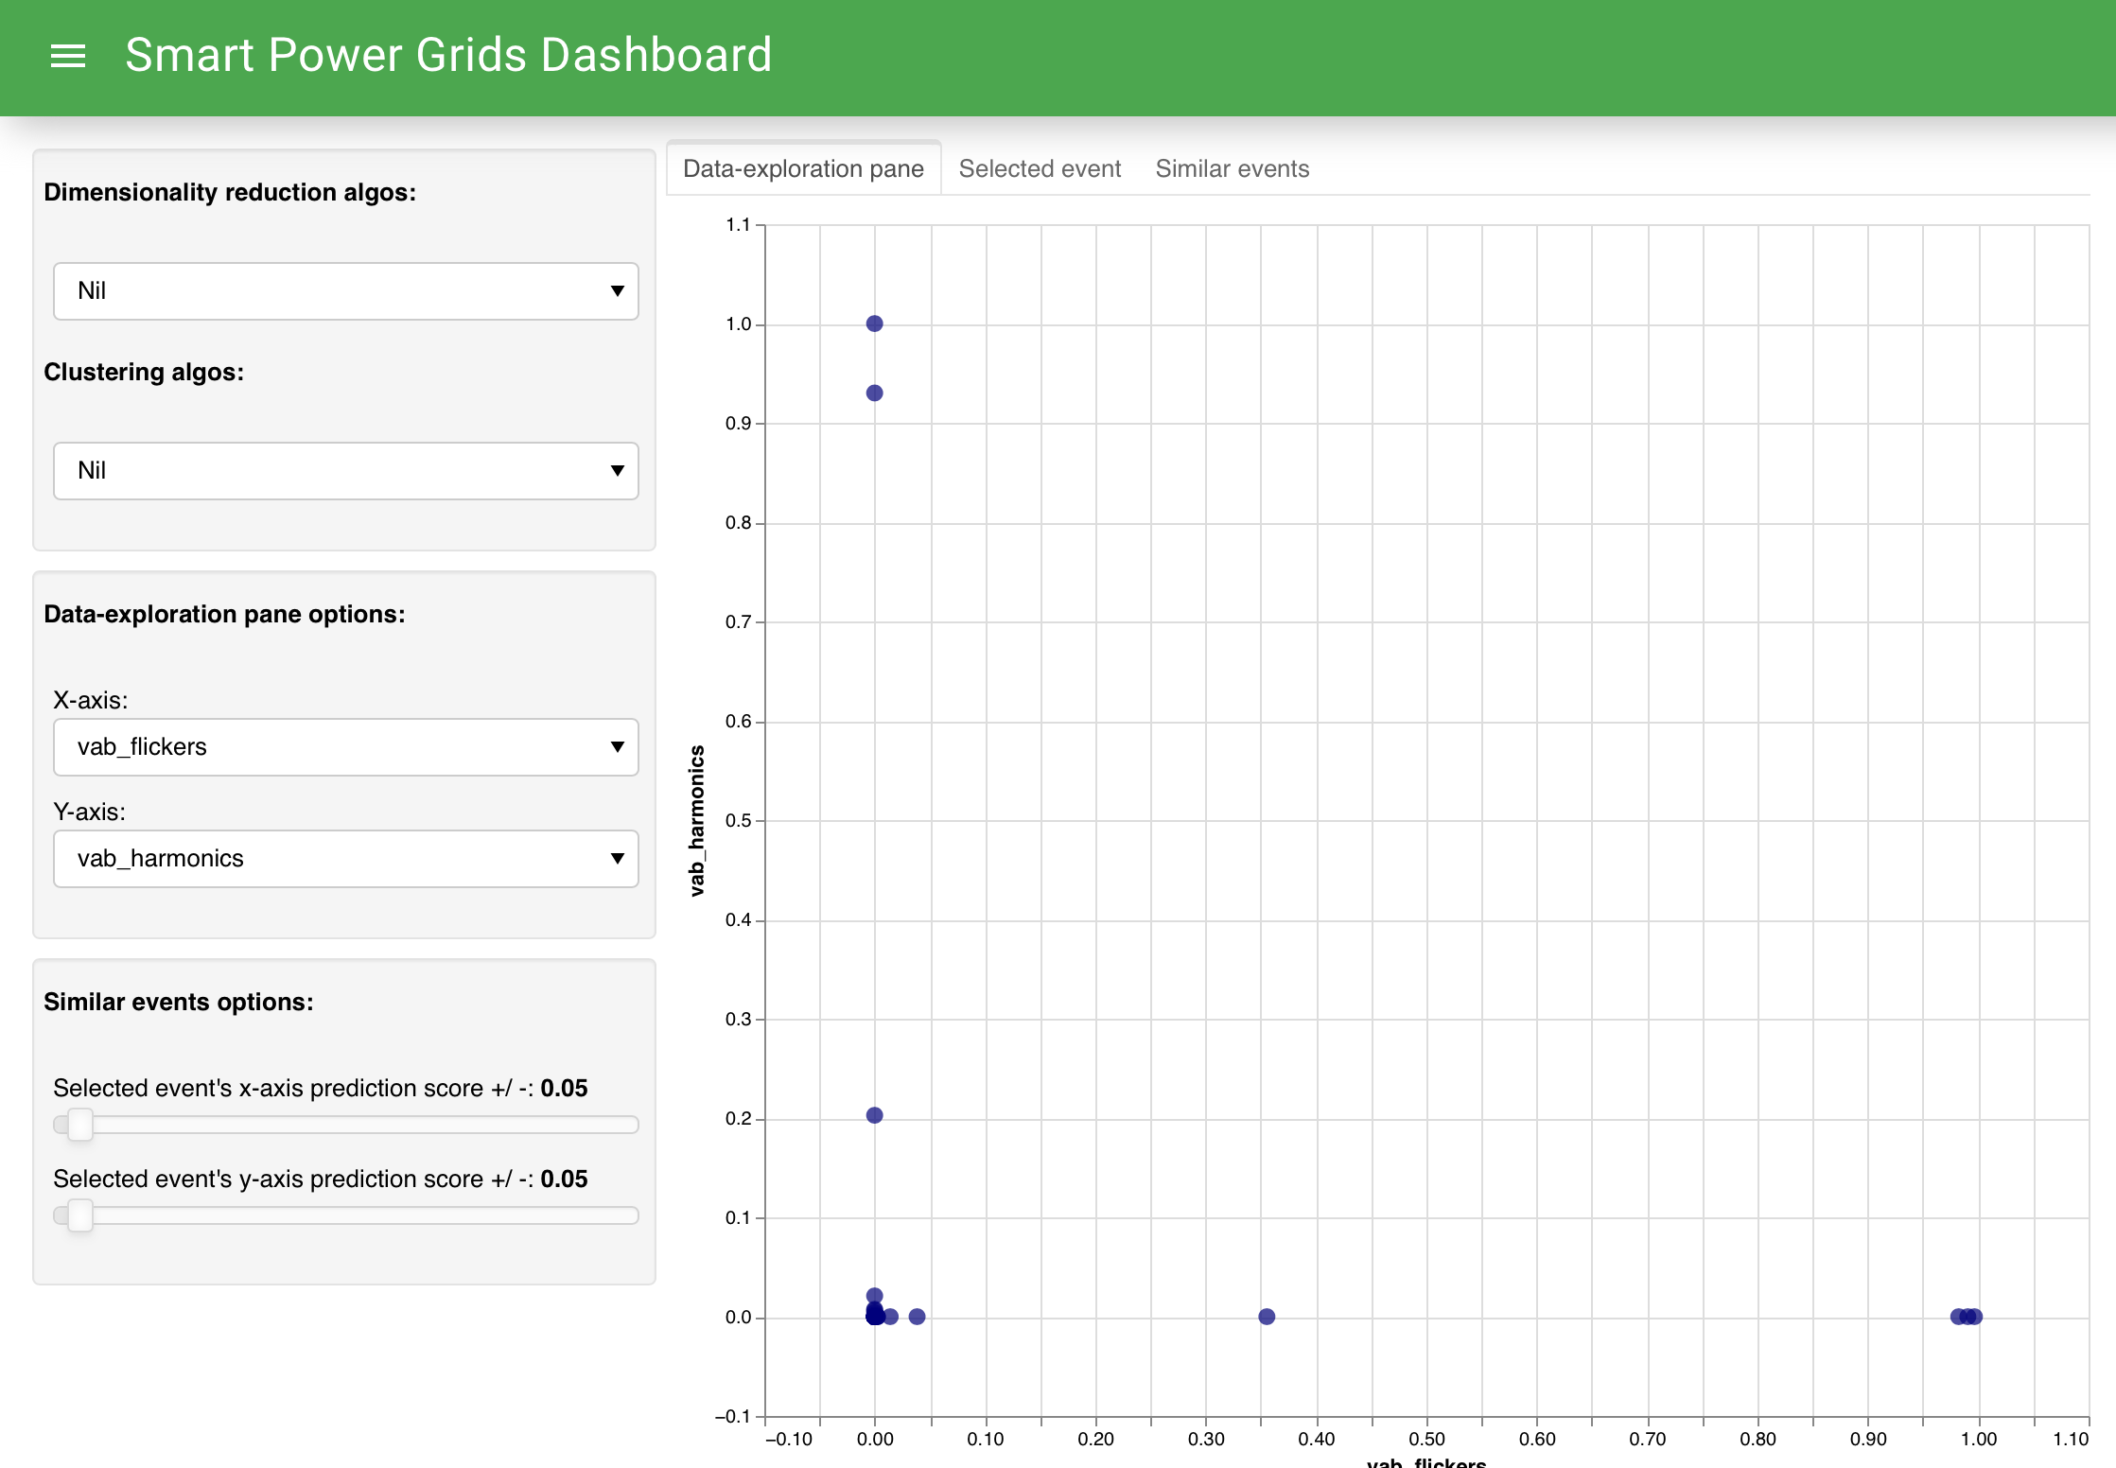
With the CNN output file, the web dashboard enables interactive data exploration
1
Load the CNN output file onto the web dashboard
2
Each dot on the scatter-plot represents a single
power quality event
3
Their locations on the plot depend on their CNN prediction scores

Slide 10
With the CNN output file, the web dashboard enables interactive data exploration (cont’d)
1
Deployable Dimensionality Reduction and
Clustering algos to change how the data is explored
2
Parameters to change how the plot is presented and how similar events are identified

Slide 11
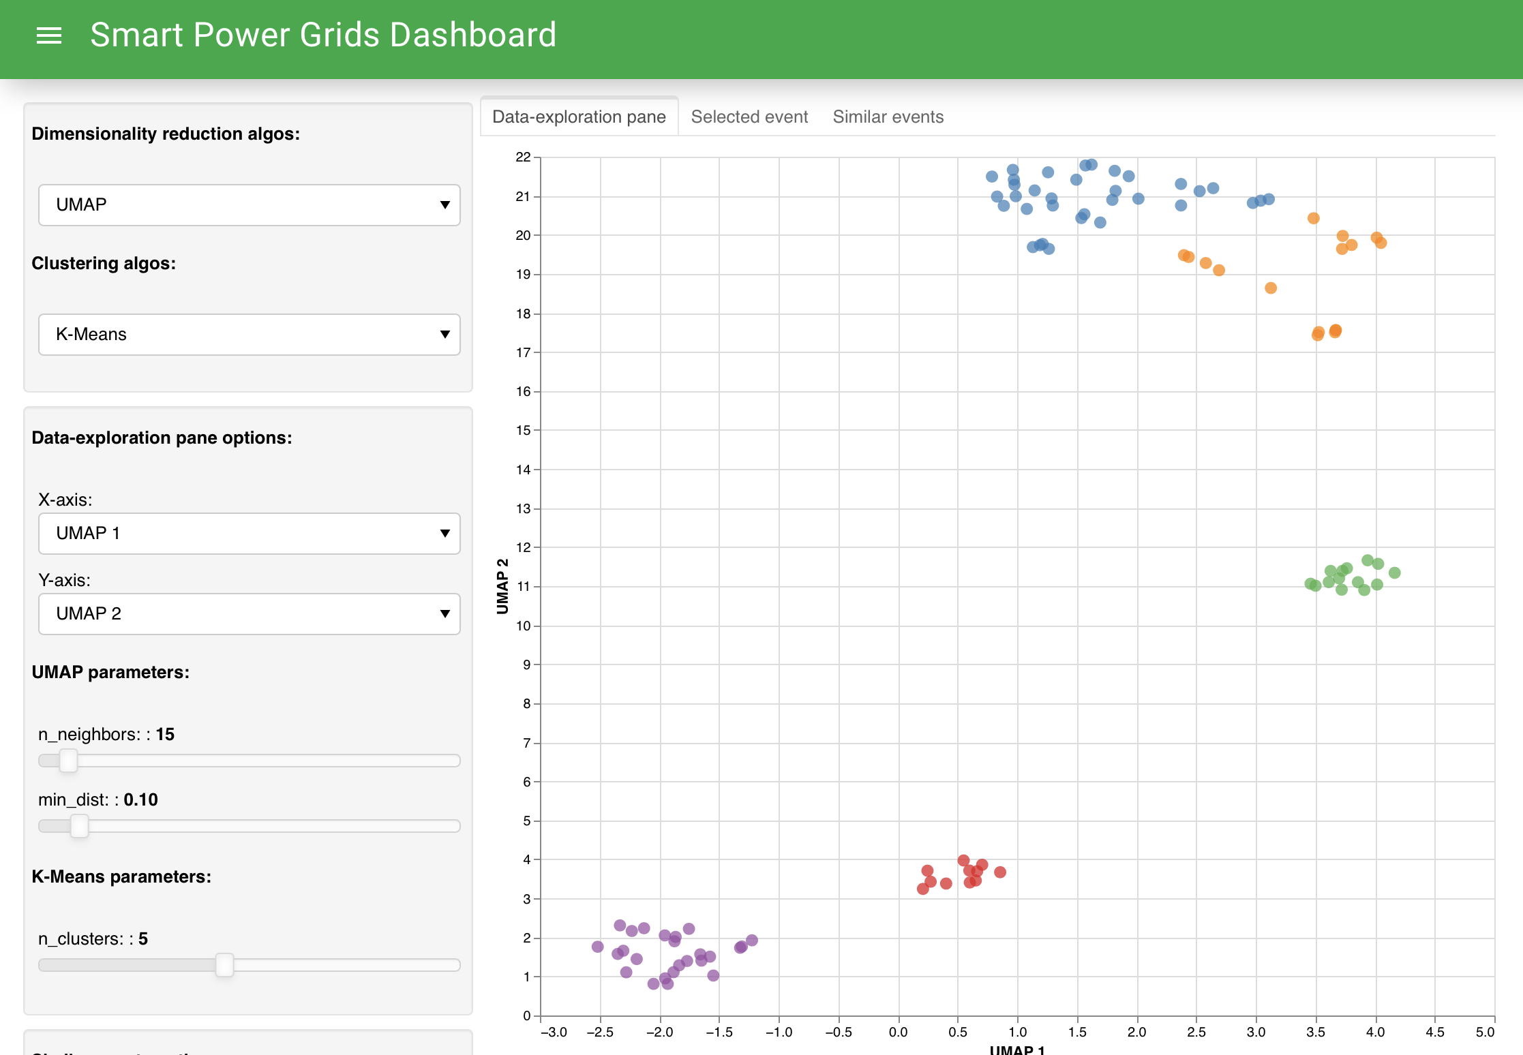
With the CNN output file, the web dashboard enables interactive data exploration (cont’d)
1
The variable algos and parameters enable interactive data-exploration
2
For example, the algos here have identified 5 main clusters of
similar events

Slide 12
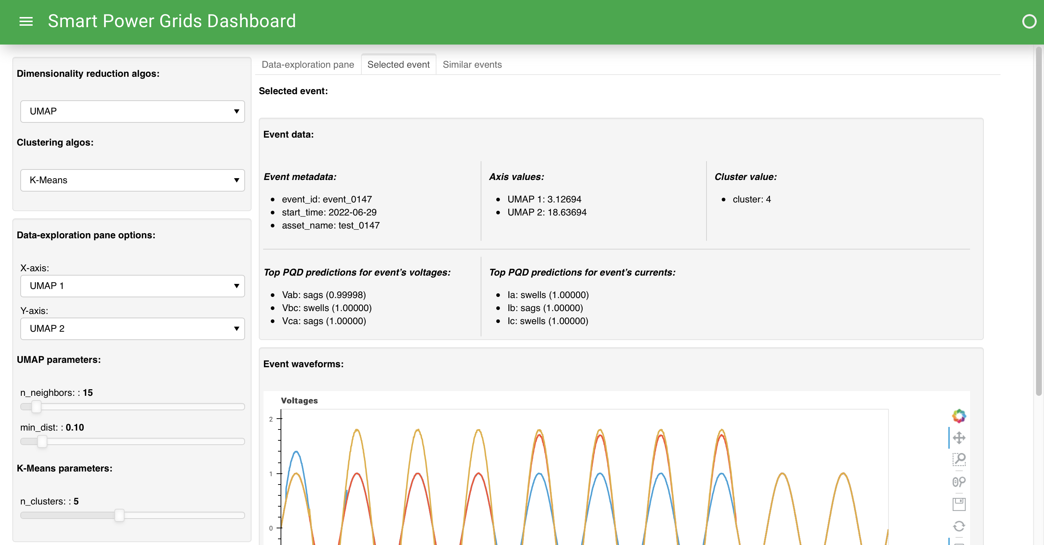
The dashboard also allows detailed examination of a single power quality event
1
The selected event’s metadata,
axis and cluster values
2
The CNN prediction scores
3
The event’s signal waveforms

Slide 13
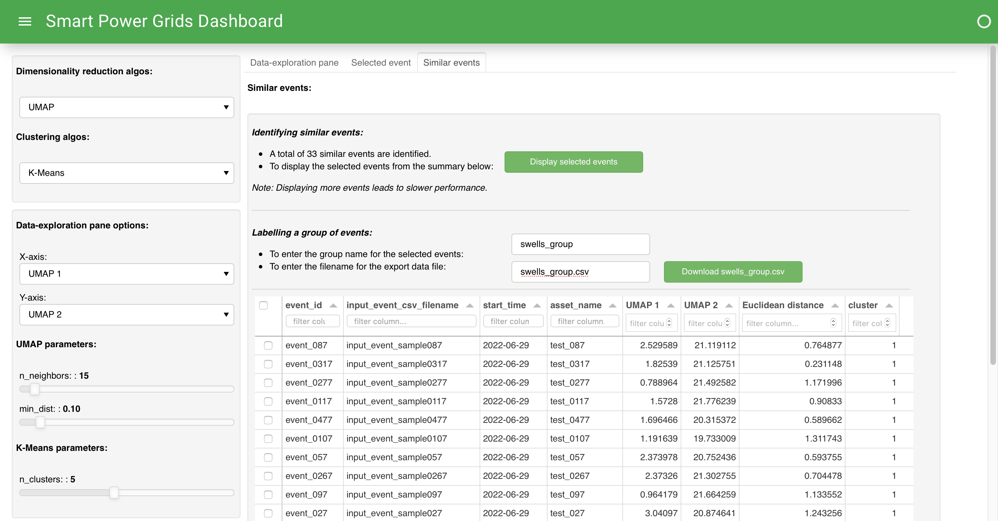
And it furthermore facilitates efficient grouping and labelling of similar events
2
Function to display the
selected similar events
3
Function to label and export the selected similar events
1
A summary of the similar events identified

Slide 14






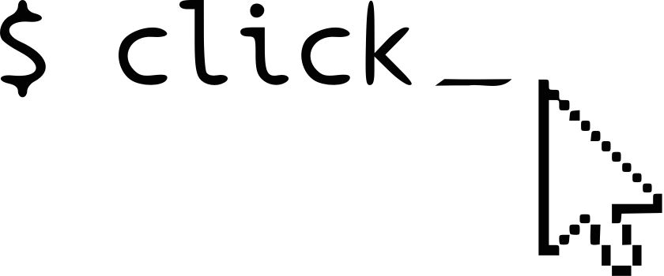
Challenges
Loss of manpower
Learn Machine Learning & Libraries
5
3

Slide 15
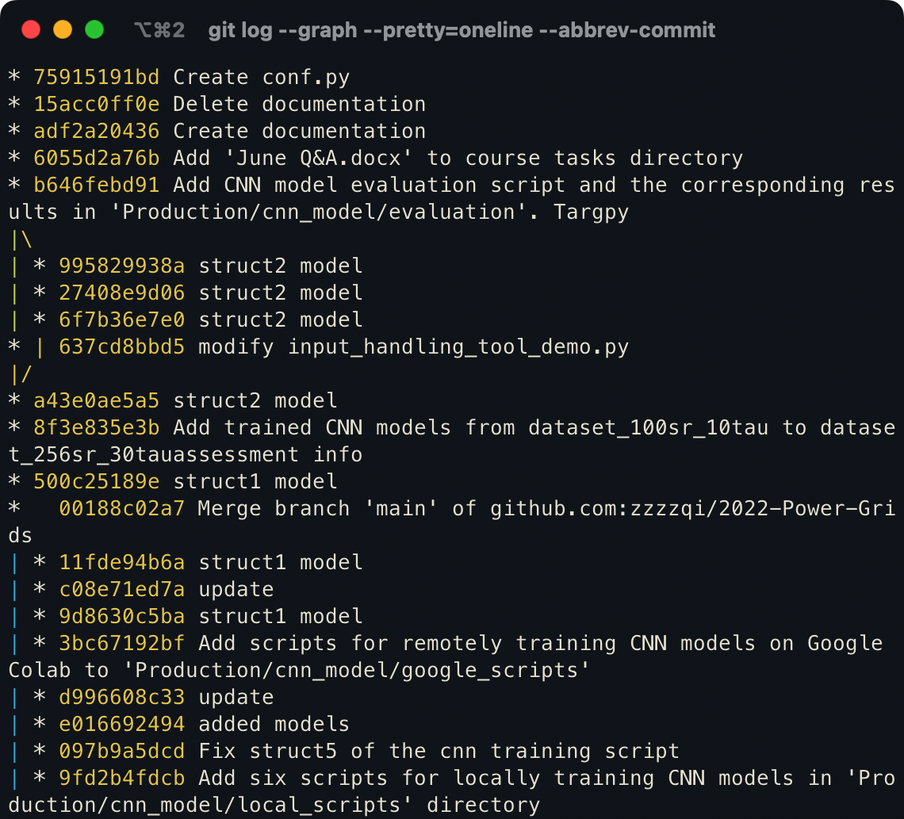
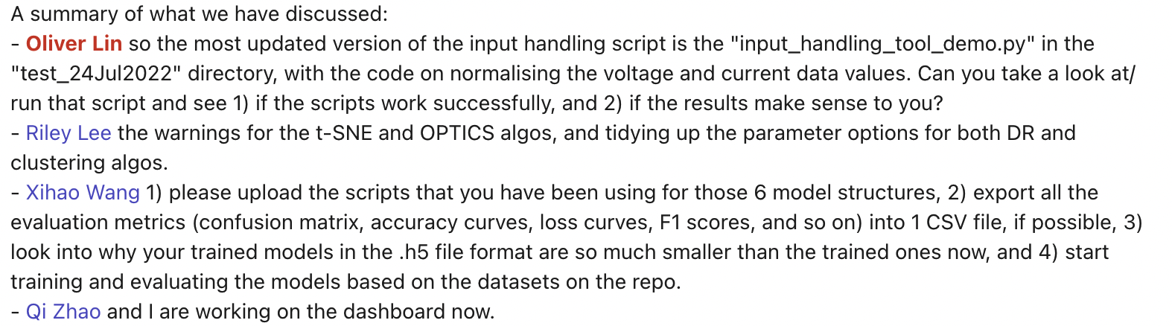
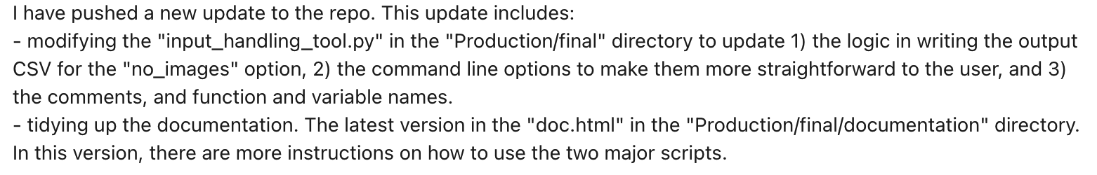
Solutions
We have been facing this challenge and have been solving it
Meeting summary
Update

Slide 16
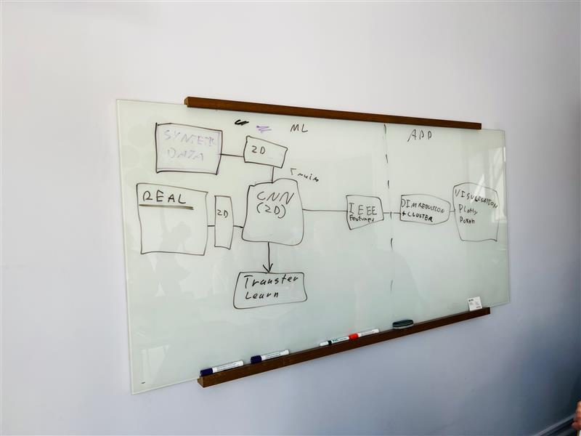
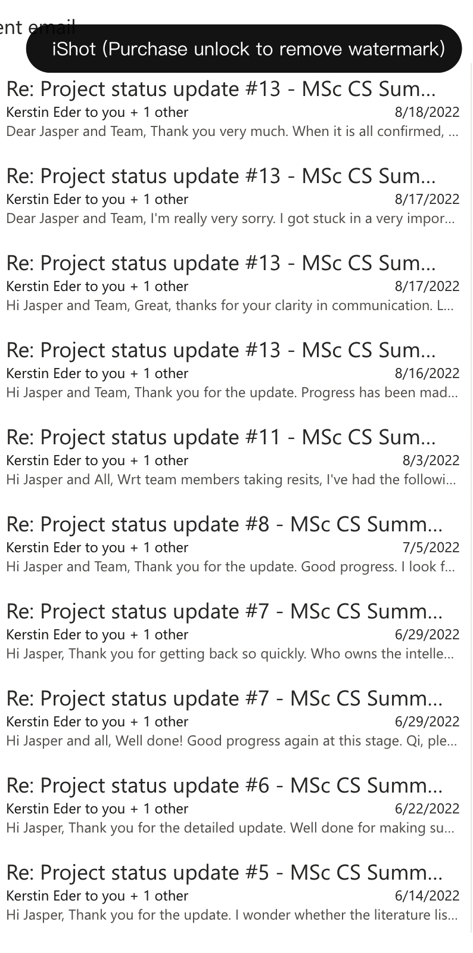


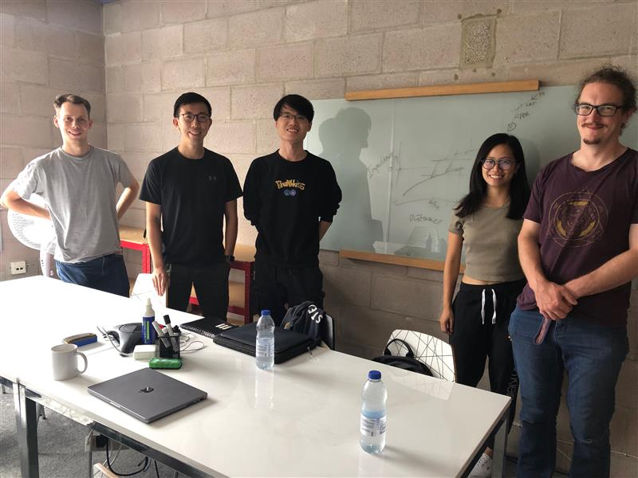
Solutions
We have been facing this challenge and have been solving it
Manage client
Communicate with supervisor
Ask for advice

Slide 17
What we have learnt
Importance of setting clear milestones
Setting specific minimum viable products and stretches
Division of tasks among team members
Being agile with our client requirements
Collecting client feedback and improving each version of our product based on that
Teamwork
Keeping everyone on the same page
Each member takes the initiative in learning, sharing and covering for each other

Slide 18
Smart Power Grids with Toumetis – Q&A session

Slide 19
PSR – how does it transform 1D time-series data into a 2D image?
1
Signal waveforms are 1D timeseries data
2
Normalize the data values (voltages and currents)
into amplitude between 2 and -2 units
3
Select the data values in between a certain time interval,
e.g. in our case 20 units of the time lag parameter
4
Plot the values with the amplitude as both the x and y axis
in greyscale images
5

Slide 20
PSR – what do the 2D PSR images of different PQD types look like?
Sags | Swells | Interruptions | Harmonics | Sags w/ harmonics
Swells w/ harmonics | Interruptions w/ harmonics | Flickers | Spikes | Oscillatory Transients

Slide 21
CNN models – how are the models trained, validated, and tested?
1
Design the CNN structure
and algorithms
The fundamental design of the CNN structure and algorithms follows the academic paper, “Classifying Power Quality Disturbances Based on Phase Space Reconstruction and a Convolutional Neural Network”, as recommended by our client
In this design, there are 2 convolution, 2 pooling, and a fully connected layer to perform the classification
2
Prepare the dataset
10,000 synthesized signals are created, and subsequently converted into a dataset of 2D PSR images into the 10 PQD categories.
This dataset is then divided, with 60% to the training set, 20% the validation set, and 20% the testing set.
This mix is recommended by Professor Andrew Ng from Stanford University in the online machine learning course the team has attended.
3
Perform the training,
validation and testing
The team has leveraged on TensorFlow libraries to train the CNN models, and free GPU hardware resources provided on Google Colab to accelerate the training process.
The training process “teaches” the CNN model to learn the differences of the images, adjusts its parameters in the neural network, become capable of categorizing input images.
The resulting accuracy level from the validation and testing sets is around 97%.

Slide 22
CNN models – how their structures, algorithms and training datasets affect their performance?
Table 1: Macro-F1 score of each of the trained CNN models
1
Trained 108 CNN models of different structures, algorithms and datasets
2
Tested their accuracy levels with a target dataset of 3,000 images with 256 signal sample rate and 20 units of the time lag parameter
The evaluation metric used is the marco-F1 score
Macro-F1 Score = True Positives/ (True Positives + 0.5 (False Positives + False Negatives))
Each category of the 10 PQD types is considered equally important in this calculation
Source: Team analysis

